Slide 1
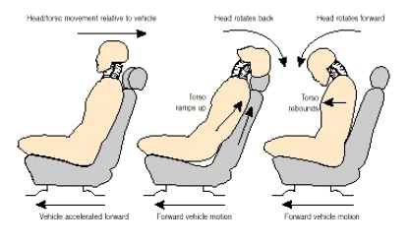
HS&E INCIDENT BULLETIN |  | 2nd half year 2016
Tribogna, Italy | Type of incident (Neck Contusion – Vehicle Accident)
Summary:
The injured person was driving outside of Tribogna for business purposes when her vehicle was struck from behind (rear-ended) by another vehicle. At the time of the accident, the employee did not report any injury. A few days later she felt a sharp pain in the neck and back. She went to the hospital and was given time off work to recover.
Root Causes: | Actions Taken Thus Far: Next Steps
Distraction of the other driver: The employee was not at fault and was wearing her seatbelt at the time of the accident. | Reinforcement of the associated HIRA that covers driving activities. Refresher training course for safe driving.

